Slide 1
50.003: Elements of Software Construction
Week 6
Basics of Concurrency: Requirements

Slide 2
It’s Not That Simple
Multi-threaded programs could have race conditions, visibility issues, deadlocks, etc.

Slide 3
Problem 1: Race Condition
Example
Program FirstError.java has 10000 threads which concurrently increment a static variable (initially 0) by 1.

Slide 4
What is the Problem?
A sequential program consisted of a sequence of instructions (and a memory), where each instruction executed one after the other (to modify the memory, etc.).
The sequential paradigm has the following two characteristics: the textual order of statements specifies their order of execution; successive statements must be executed without any overlap (in time) with one another.
Both are not true in concurrent programs.

Slide 5
The Illusion
int previousMax;
0. public int max (int[] list) {
1. int max = list[0];
2. for (int i = 1; 3. i < list.length; 4. i++) {
5. if (max < list[i]) {
6. max = list[i];
7. }
8. }
9. previousMax = max;
10. return max;
11. }
0
list = …
1
max = list[0]
2
i = 1
i >= list.length
9
3
previous=max
i < list.length
i++
return max
10
4
5
max >= list[i]
max < list[i]
…
11
8
7
6
max = list[i]

Slide 6
Control Flow Graph
memory
0
previousMax | …
previousMax | …
input | …
list = …
1
max = list[0]
2
i = 1
i >= list.length
9
3
previous=max
i < list.length
i++
return max
10
4
5
max >= list[i]
max < list[i]
…
11
8
7
6
max = list[i]

Slide 7
System Execution
memory
0
previousMax | …
previousMax | 0
input | [2,4]
list = …
1
max = list[0]
2
i = 1
i >= list.length
9
3
previous=max
i < list.length
i++
return max
10
4
5
max >= list[i]
max < list[i]
…
11
8
7
6
max = list[i]

Slide 8
System Execution
memory
0
previousMax | …
previousMax | 0
input | [2,4]
list | [2,4]
list = …
1
max = list[0]
2
i = 1
i >= list.length
9
3
previous=max
i < list.length
i++
return max
10
4
5
max >= list[i]
max < list[i]
…
11
8
7
6
max = list[i]

Slide 9
System Execution
memory
0
previousMax | …
previousMax | 0
input | [2,4]
list | [2,4]
max | 2
list = …
1
max = list[0]
2
i = 1
i >= list.length
9
3
previous=max
i < list.length
i++
return max
10
4
5
max >= list[i]
max < list[i]
…
11
8
7
6
max = list[i]

Slide 10
System Execution
memory
0
previousMax | …
previousMax | 0
input | [2,4]
list | [2,4]
max | 2
i | 1
list = …
1
max = list[0]
2
i = 1
i >= list.length
9
3
previous=max
i < list.length
i++
return max
10
4
5
max >= list[i]
max < list[i]
…
11
8
7
6
max = list[i]

Slide 11
System Execution
memory
0
previousMax | …
previousMax | 0
input | [2,4]
list | [2,4]
max | 2
i | 1
list = …
1
max = list[0]
2
i = 1
i >= list.length
9
3
previous=max
i < list.length
i++
return max
10
4
5
max >= list[i]
max < list[i]
…
11
8
7
6
max = list[i]

Slide 12
System Execution
memory
0
previousMax | …
previousMax | 0
input | [2,4]
list | [2,4]
max | 2
i | 1
list = …
1
max = list[0]
2
i = 1
i >= list.length
9
3
previous=max
i < list.length
i++
return max
10
4
5
max >= list[i]
max < list[i]
…
11
8
7
6
max = list[i]

Slide 13
System Execution
memory
0
previousMax | …
previousMax | 0
input | [2,4]
list | [2,4]
max | 4
i | 1
list = …
1
max = list[0]
2
i = 1
i >= list.length
9
3
previous=max
i < list.length
i++
return max
10
4
5
max >= list[i]
max < list[i]
…
11
8
7
6
max = list[i]

Slide 14
System Execution
memory
0
previousMax | …
previousMax | 0
input | [2,4]
list | [2,4]
max | 4
i | 1
list = …
1
max = list[0]
2
i = 1
i >= list.length
9
3
previous=max
i < list.length
i++
return max
10
4
5
max >= list[i]
max < list[i]
…
11
8
7
6
max = list[i]

Slide 15
System Execution
memory
0
previousMax | …
previousMax | 0
input | [2,4]
list | [2,4]
max | 4
i | 1
list = …
1
max = list[0]
2
i = 1
i >= list.length
9
3
previous=max
i < list.length
i++
return max
10
4
5
max >= list[i]
max < list[i]
…
11
8
7
6
max = list[i]

Slide 16
System Execution
memory
0
previousMax | …
previousMax | 0
input | [2,4]
list | [2,4]
max | 4
i | 2
list = …
1
max = list[0]
2
i = 1
i >= list.length
9
3
previous=max
i < list.length
i++
return max
10
4
5
max >= list[i]
max < list[i]
…
11
8
7
6
max = list[i]

Slide 17
System Execution
memory
0
previousMax | …
previousMax | 0
input | [2,4]
list | [2,4]
max | 4
i | 2
list = …
1
max = list[0]
2
i = 1
i >= list.length
9
3
previous=max
i < list.length
i++
return max
10
4
5
max >= list[i]
max < list[i]
…
11
8
7
6
max = list[i]

Slide 18
Reality is Messy
Java Programs
Bytecode
What are the atomic steps?
JVM
What are the order of execution?
Physical Machine
What and where are the variable values?

Slide 19
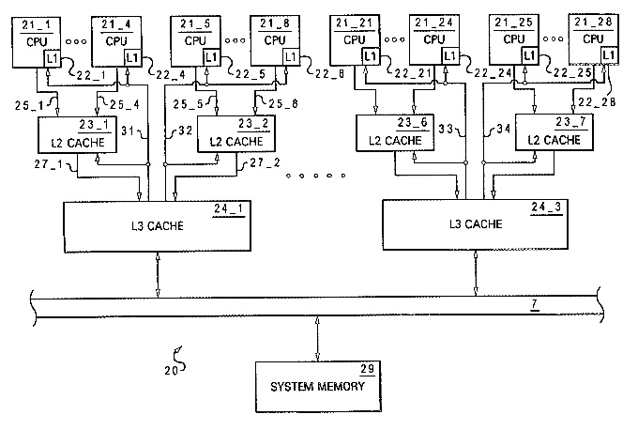
Scheduling
threads
Thread1
Thread2
Thread3
Thread4
Scheduler
The scheduler is ‘un-predictable’

Slide 20
Is This Real?
Thread1
Thread2
0
0
00
count = 0
count++
count++
➔
count = 1
01
10
count = 1
1
1
11
count = 2
This is assuming that count++ is one step. Or is it?

Slide 21
What Really Happened?
Thread1
Thread2
0
0
read value of Count and assign it to a register
read value of Count and assign it to a register
1
1
Increment the register
Increment the register
2
2
Write the register value back to Count
Write the register value back to Count
3
3
For double type, even read/write is not atomic!

Slide 22
What Really Happened?
Thread1
Thread2
00
r2
r1
0
0
01
10
r1
r2
i2
i1
1
1
02
11
20
w2
w1
i1
i2
03
12
21
30
2
2
r1
r2
w1
w2
13
22
31
3
3
i1
i2
23
32
w1
w2
33

Slide 23
What Really Happened?
Thread1
Thread2
00
r2
0
0
01
10
r1
r2
r1
1
1
02
11
20
i2
i1
i2
03
12
21
30
2
2
i1
w1
w2
13
22
31
w1
3
3
23
32
w2
count=1
33
Is this correct?

Slide 24
A Joke
Some people, when confronted with a problem, think, 'I know, I'll use threads' - and then two they hav erpoblesms.

Slide 25
AtomicXXX
If the shared variable is of a type Boolean, int, int array, and etc., use classes in package java.util.concurrent.atomic
Example:
AtomicInteger x = new AtomicInteger(0)
x.incrementAndGet() //increments x by 1 atomically
Example: FirstErrorFixed.java

Slide 26
Compound Actions
Sometime it is not sufficient to simply use an AtomicXXX object.
//withdraw from a bank account
//check and update
if (amount >= 1000) {
amount = amount - 1000;
}
Refer to example: SecondError.java

Slide 27
Intrinsic Locks
Every Java object can implicitly act as a lock for purposes of synchronization.
synchronized (lock) {
//Access shared state guarded by lock
}
Intrinsic locks acts as mutexes (mutual exclusion locks), i.e., at most one thread may own the lock.
Since only one thread at a time can execute a block of code guarded by a given lock, the synchronized blocks guarded by the same lock execute atomically with respect to one another.

Slide 28
How Lock Works
Thread1
Thread2
0
0
acquire lock
acquire lock
1
1
r1
r2
2
2
i1
i2
3
3
w1
w2
4
4
release lock
release lock
5
5
SecondErrorFixed.java

Slide 29
Cohort Exercise 3
Assuming that we would like to maintain that “saving + cash = 5000” always, fix the following class: LockStaticVariables.java.
Hint: Think about what is the lock?
Name your solution as: LockStaticVariablesFixed.java

Slide 30
wait() and notify()
Busy waiting is not efficient
Consider a voting system with two threads. One collects votes and the other is waiting to count the votes when the voting is completed.
while (true) {
synchronized(this) {
if (votingComplete) {
break;
}
}
}
Use wait()/nofityAll() to avoid busy waiting
Voting.java

Slide 31
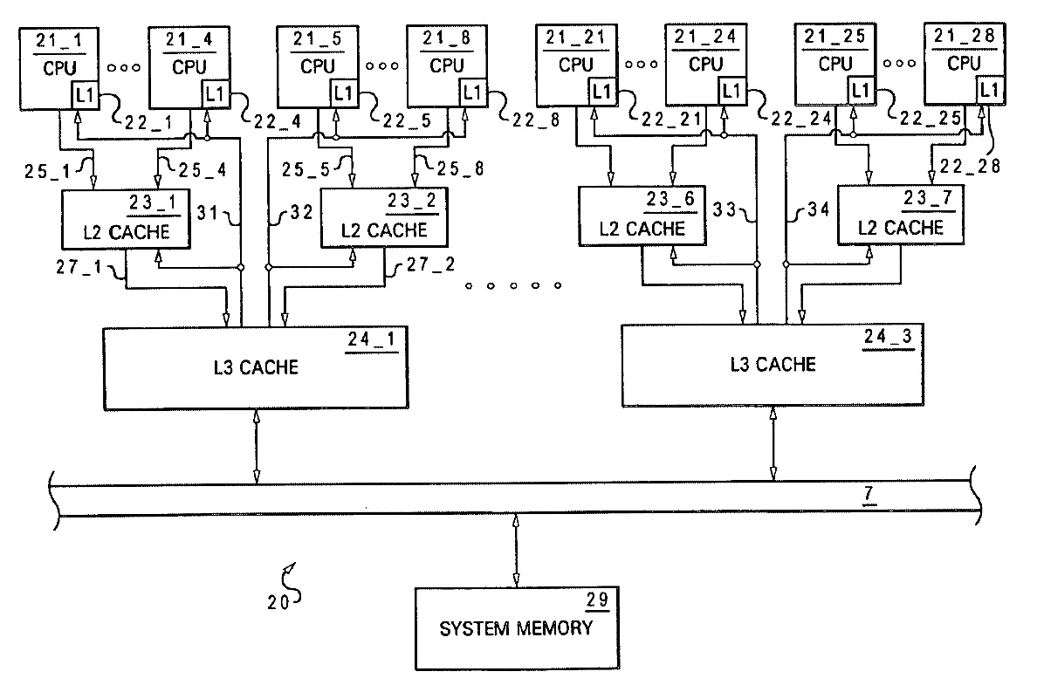
Problem 2: Visibility
old found
new found
How could we know where?
Example: FactorThread.java

Slide 32
Problem 3: Execution Ordering
Initially A, B, r1 and r2 are all 0.
What are the values of the variables after both threads complete?
Is it possible to have B = 1 and r2 = 2 and A = 2 and r1 = 1?
Thread 1 | Thread 2
1: r2 = A; | 3: r1 = B;
2: B = 1; | 4: A = 2;

Slide 33
What are the order of execution?
Java compiler might switch the order of sequential statements (e.g., for efficiency)
Example: line 2 and line 3 might be switched
1. x++;
2. y++;
3. x++;
How could we know the order of execution?
Self-read: Java Memory Model

Slide 34
Cohort Exercise 4
Producer/Consumer Pattern
Exercise: fixed the Buffer class in BufferExample.java so that it is thread-safe and efficient
Can you point out all the potential order of execution before and after your fix?
BoundedBuffer
Producer Thread 1
Producer Thread 2
…
Consumer Thread 1
Consumer Thread 2
…
addItem
removeItem

